Slide 1
On 23 June, birthday celebrations will be held around the world. Why?

Slide 2
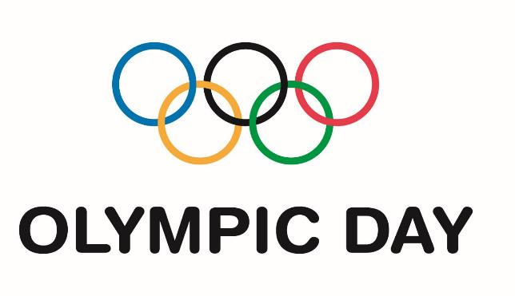
It’s International Olympic Day, the birthday of the modern Olympic Games. Let’s celebrate!

Slide 3
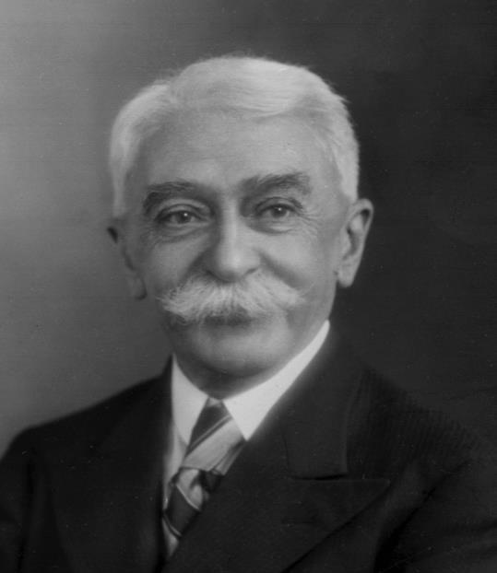
Frenchman, Pierre de Coubertin, set up the International Olympic Committee on 23 June 1894. He was an enthusiastic sportsman who enjoyed boxing, fencing, horse-riding and rowing.

Slide 4
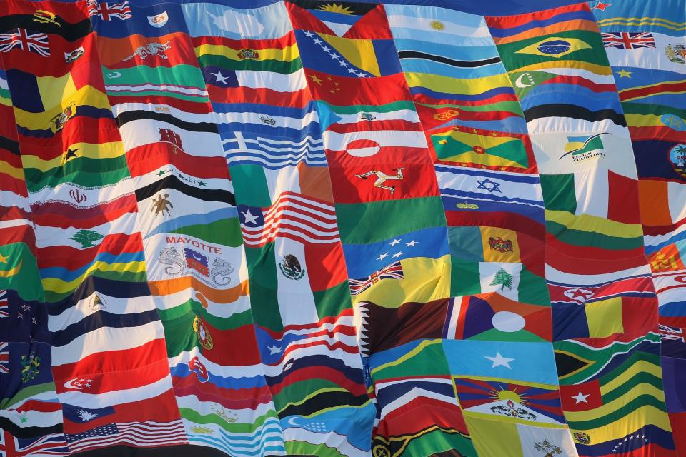
He wanted to bring people from around the world together to take part in friendly athletic competition, to build a better world through sport.

Slide 5
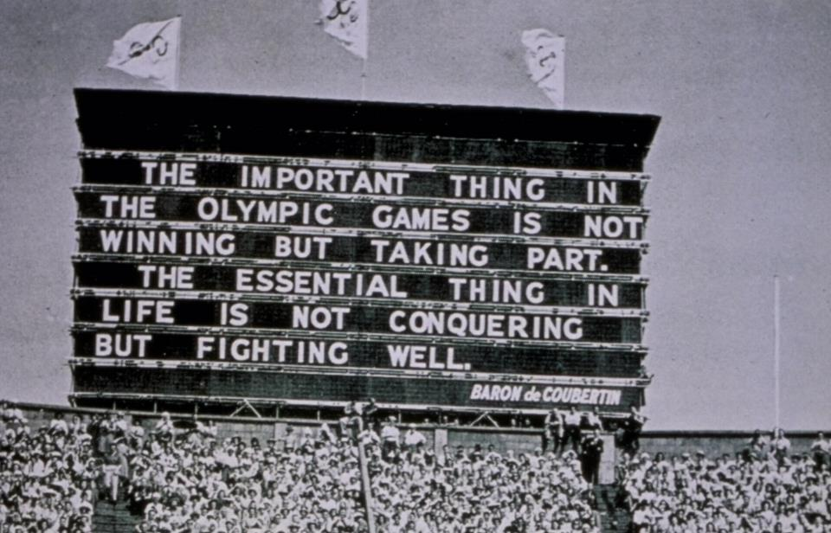
He believed that taking part and doing your very best is more important than winning.

Slide 6
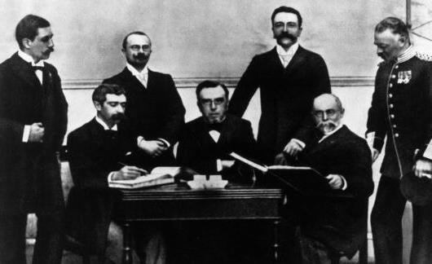
The modern Olympic Games
Organised by the International Olympic Committee, the first modern Olympic Games took place in Athens, Greece in 1896.

Slide 7
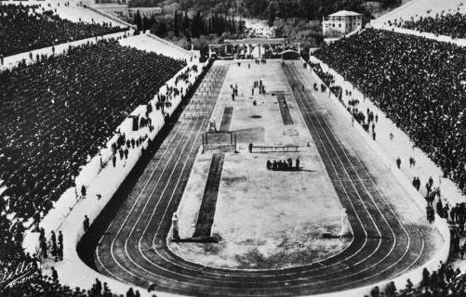
245 athletes from 14 countries competed in the Games and Great Britain was one of them!

Slide 8
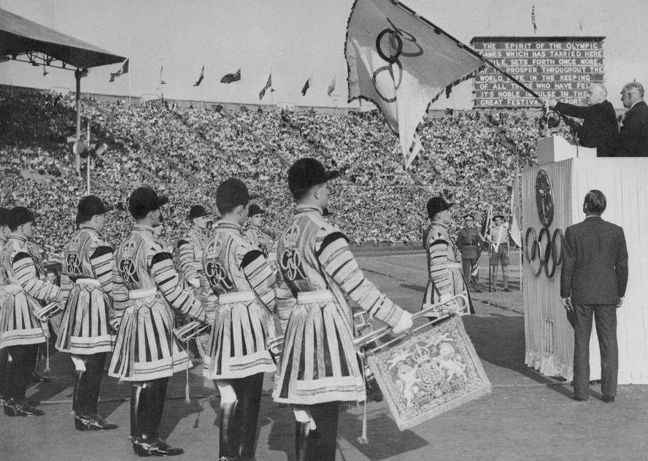
The first International Olympic Day was celebrated on 23 June 1948.
Austria, Belgium, Canada, Great Britain, Greece, Portugal, Switzerland, Uruguay and Venezuela
all held events.

Slide 9
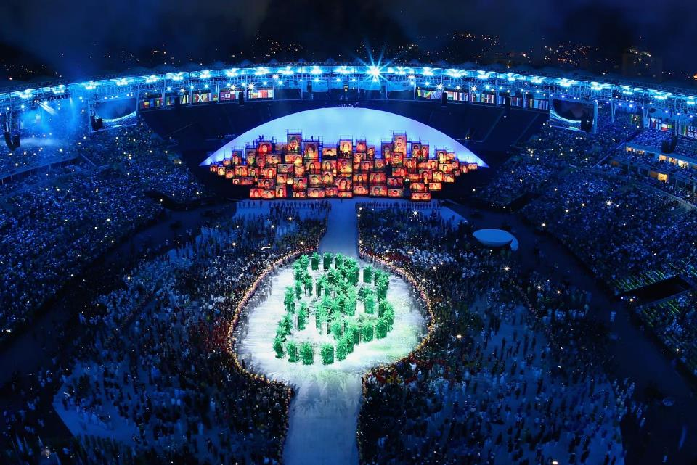
The Olympic Games have grown and grown!
More than 10,000 athletes from 205 nations participated at Rio 2016.

Slide 10
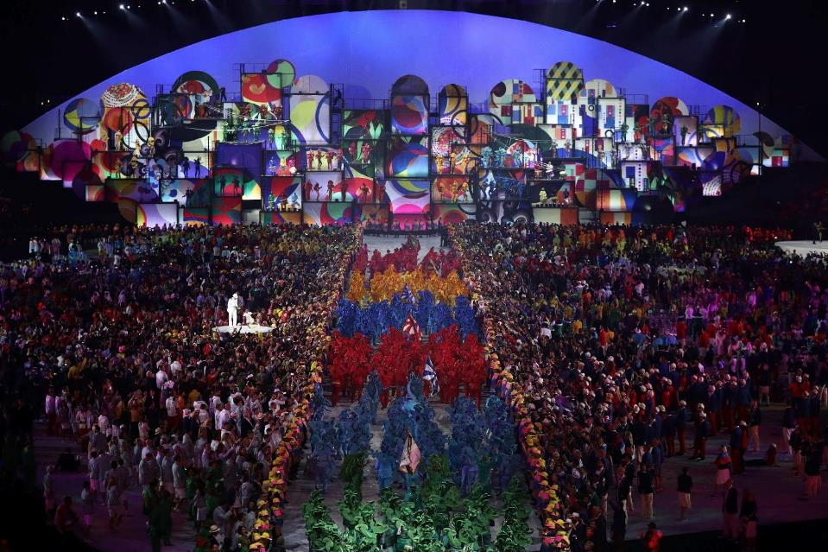
So on Olympic day there’s lots to celebrate!

Slide 11
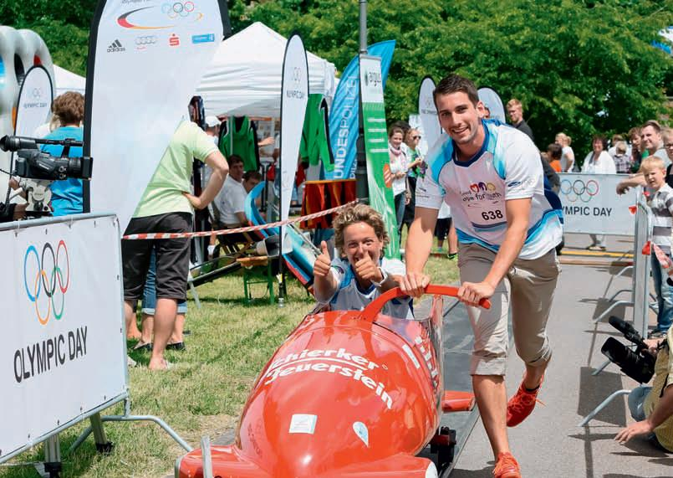
People of all ages, from all over the world, celebrate Olympic Day through one of its three pillars: move, learn, and discover!

Slide 12
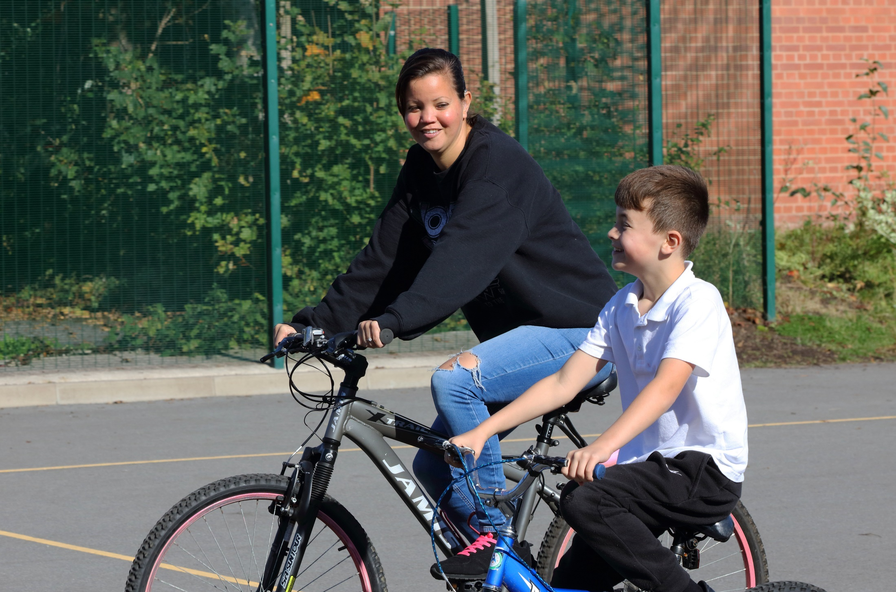
Whether getting active on your bike…

Slide 13
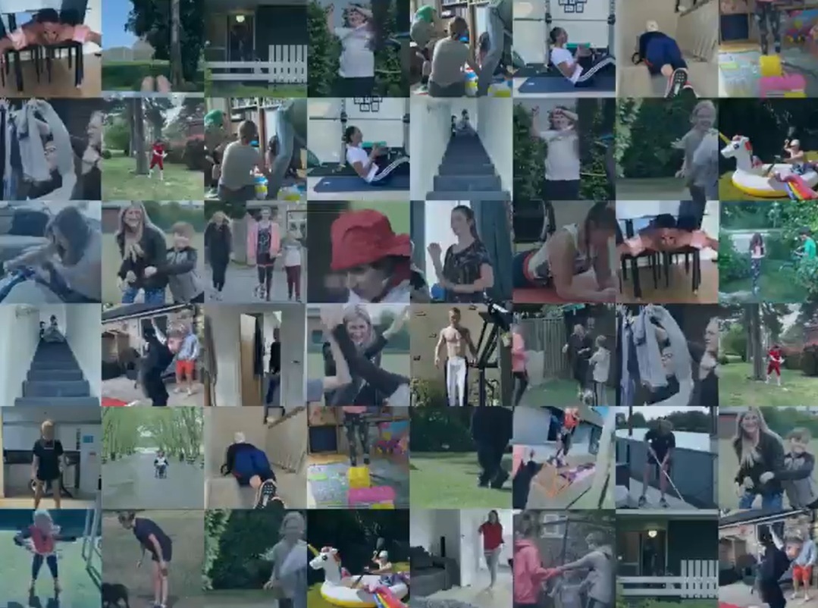
…learning new skills at home…

Slide 14
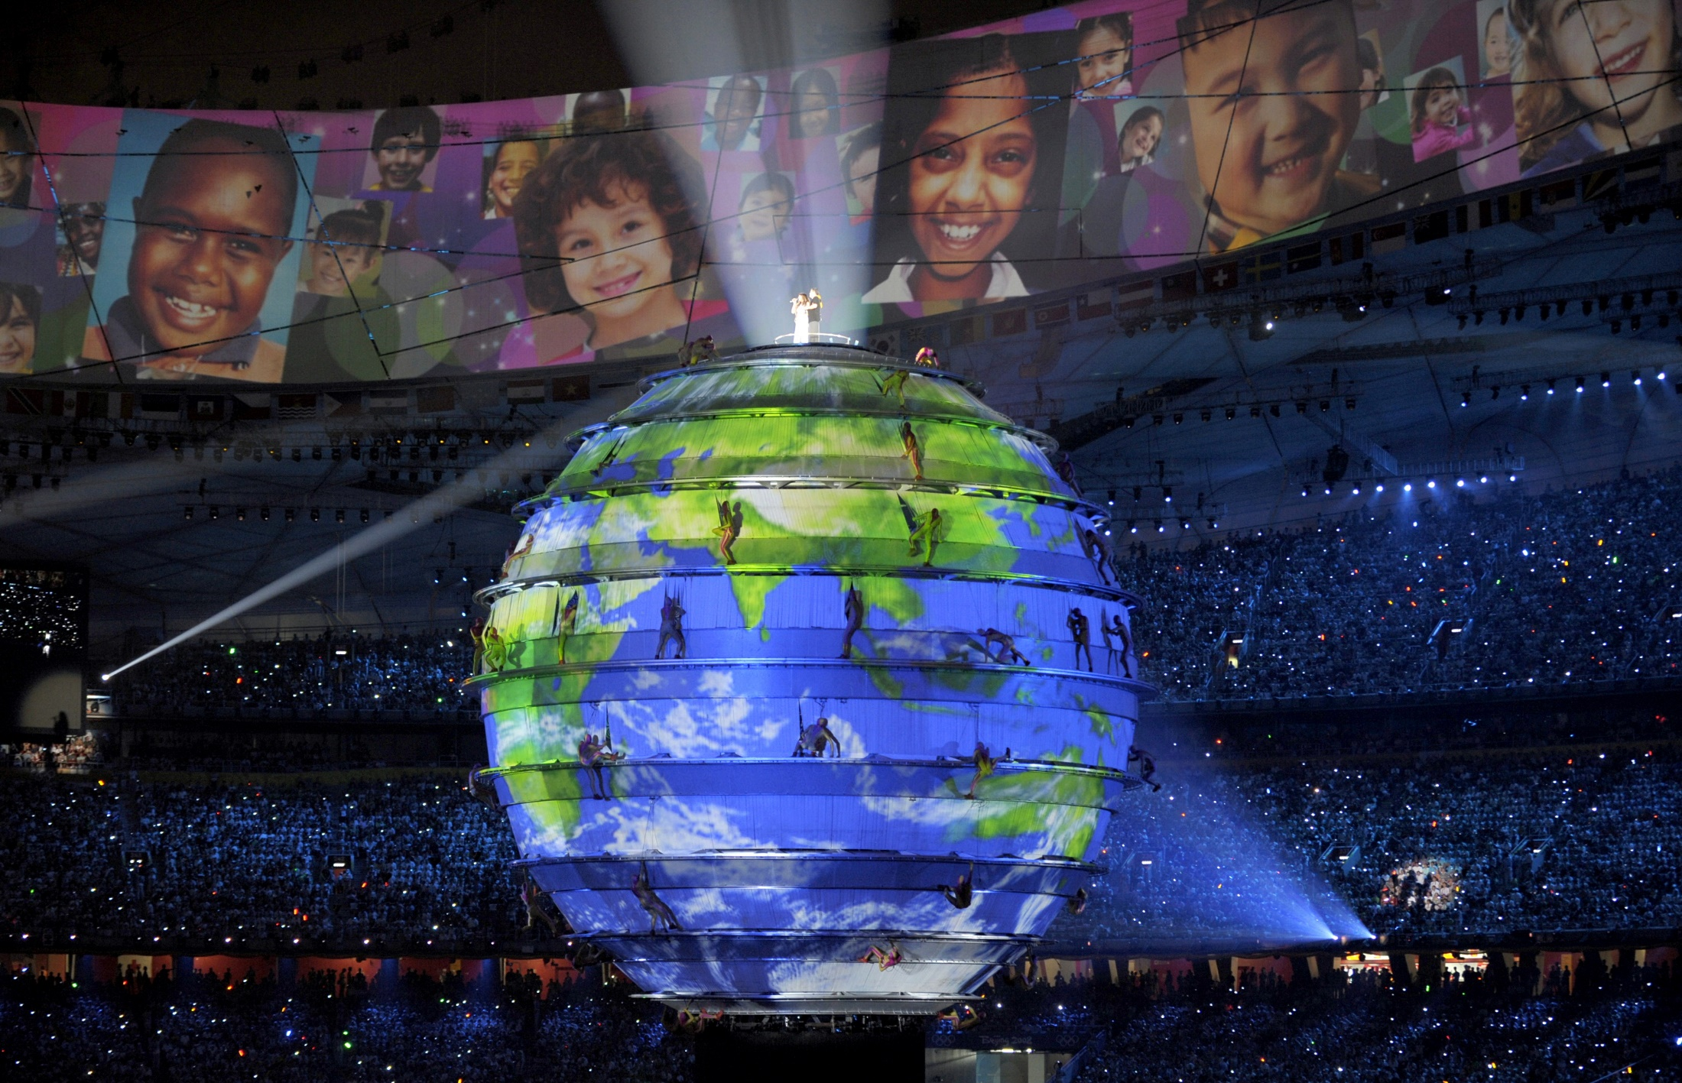
…or discovering more about different Olympic nations around the world!

Slide 15
What are you going to do?
Think about what you could do to celebrate International Olympic Day!
Remember to share your plans and activities online!
@GetSetCommunity @GetSetClub getset.co.uk/community

Slide 16
But first – what do you remember?
Who founded the modern Olympic movement?
Pierre de Coubertin
Andrew Wenlock
Ludwig Guttman
When was the first modern Olympic Games held?
1894
1896
1948
How many nations took part?
26
14
205
How many nations took part in the Games at Rio 2016?
245
10,000
205

Slide 17
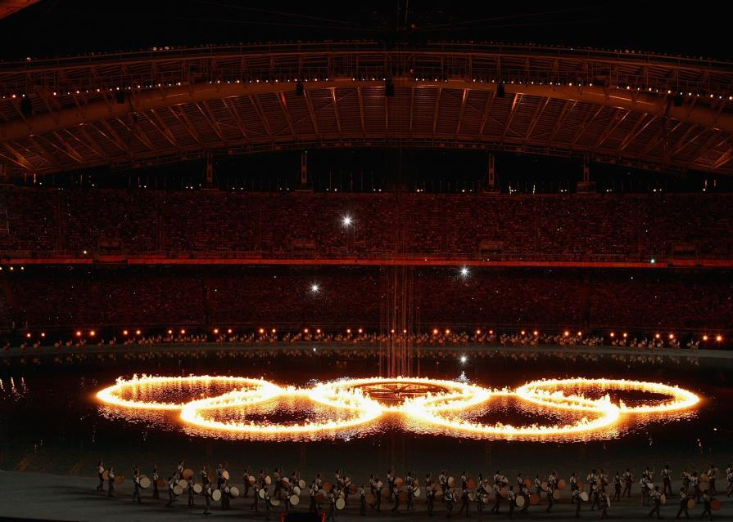
Happy birthday modern Olympic Games!
Take part, do your best and have fun.

